Slide 1
Microsoft Power Platform + Dynamics 365
Notes:
Hi, Welcome to Microsoft Power Platform + Dynamics 365 Bootcamp.

Slide 2
Course Overview
Day 1
Empowering Everyone with Power Platform – From CEO to Frontline Workers
Introduction to Power Platform
Day 2
Power Packed Day with Power Canvas Apps
Introduction to PowerApps
Day 3
Power Packed Day with Power Model Driven Apps
Let’s talk about data
Day 4
Power Packed Day with Power Automate
Introduction
Day 5
Power Packed Day with Power Virtual Agents
Introduction
Microsoft Power Platform momentum
Why Power Platform?
Customer Stories
Demo
Benefits of PowerApps
What can I build with PowerApps?
Types of PowerApps
Canvas Apps
Data Sources and Connectors
Demo
Types of flow
Data types and expression
Working with Arrays
Control flow and action settings
Demo
Types of Data
Common Data Service
Model-driven Apps
What type of components can I add?
Data model design
Demo
A Robust Virtual Agent Platform
Converse everywhere
Easily make your bots better
Create personalized customer experiences
Transfer to a human agent
Built on Power Platform & Azure Bot Service
Extend your bot capabilities with Azure Bot Service
Demo

Slide 3
Continue…
Day 6
Power Packed Day with Power BI
Introduction
Day 7
Power up your Apps with AI Builder
Introduction
Day 8
Power Platform Administration, Security & Integration Connectors
Introduction
Day 9
Power Packed Bizz Apps Day – Sales & Marketing
Introduction
Day 10
Power Packed Bizz Apps Day– Finance & Supply Chain
Introduction
AI for every app. And everyone
Setup Environment
Types of AI Model
Prediction
Form processing
Object detection
Text classification
Demo
The 5x5 Principle
Customer momentum: Power BI
Power BI Desktop
Data sources
Power Query
Dataflow
Using a Calculation (DAX) in multiple files
Paginated Reporting
Power BI Admin Portal
Demo
Secure your tenant
Monitor your tenant’s activity
Alert & act on that activity
Connectors
SharePoint Integration
Demo
Nurture more demand
Personalize buyer experiences
Build relationships at scale
Make insight-driven decisions
Demo
How to embed PowerApps in Dynamics 365 for Sales and Marketing
Technology Modernization
Modern Finance
Supporting modern supply chain management
Demo
How to embed Power Platform in Dynamics 365 for Finance and Supply Chain

Slide 4
Day 7: Power up your Apps with AI Builder

Slide 5

Agenda
Introduction
AI for every app. And everyone
Setup Environment
Types of AI Model
Prediction
Form processing
Object detection
Text classification
Demo
Lab9-Object detection
Lab10-Form processing

Slide 6

Implementation complexity Access to AI needs to be made easy!

Slide 7

Business expertise AI’s untapped potential lies in the hands of those with business problems to solve

Slide 8
AI must be democratized to accelerate digital transformation
we are here
Paper-based
Manual
Experts
App-based
Digital
Business users
Apps + AI
Automated
Business users

Slide 9

Talent shortage But most of them lack access to data scientists and pro-developers

Slide 10


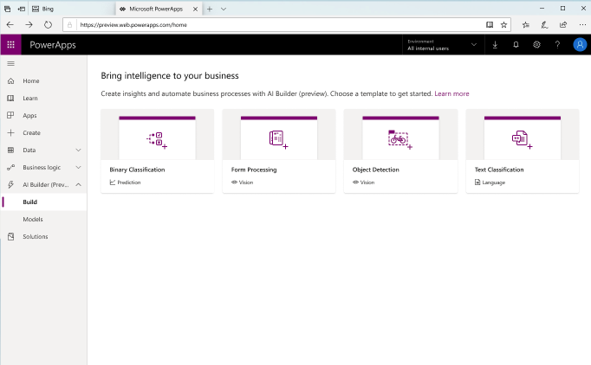
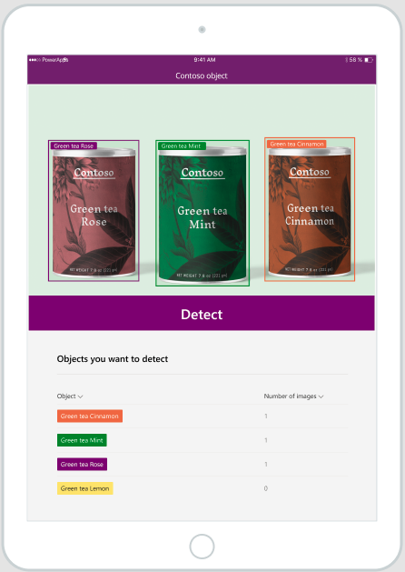
AI Builder AI for every app. And everyone. ​

Slide 11
Microsoft PowerApps AI Builder - Supported regions
Currently, AI Builder is available in United States and Europe only. AI Builder features will not be available in environments created outside United States or Europe.
AI Builder was released for public preview on June 10, 2019 in Europe and United States.
https://docs.microsoft.com/en-us/ai-builder/availability-region

Slide 12
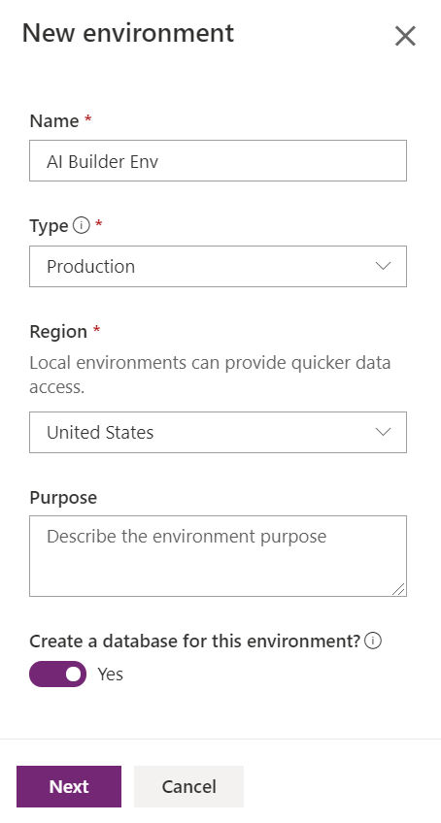
Setup Environment
Create new environment
Select region United States or Europe
Select Yes on create a database for this environment

Slide 13
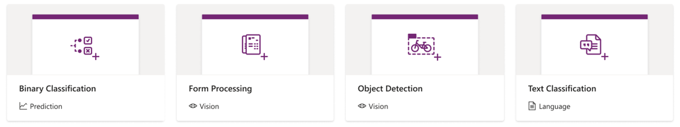
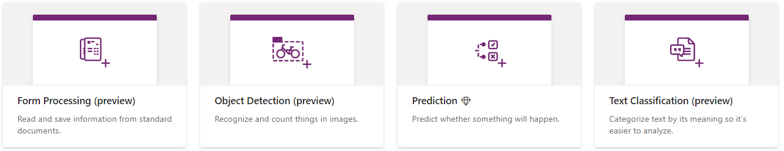
Types of AI Model - Add Intelligence to your business
Now
Notes:
Binary Classification

Slide 14
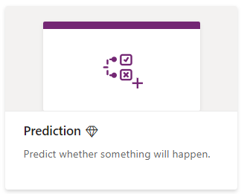


Prediction
Predict yes/no business outcomes based on
historical data patterns with historical outcomes.
Examples
Will this customer churn (yes/no)?
Which loan risk profile for this customer (low/high)
AI builder
< 1 hour
Point & Click
Process
Automation

Slide 15
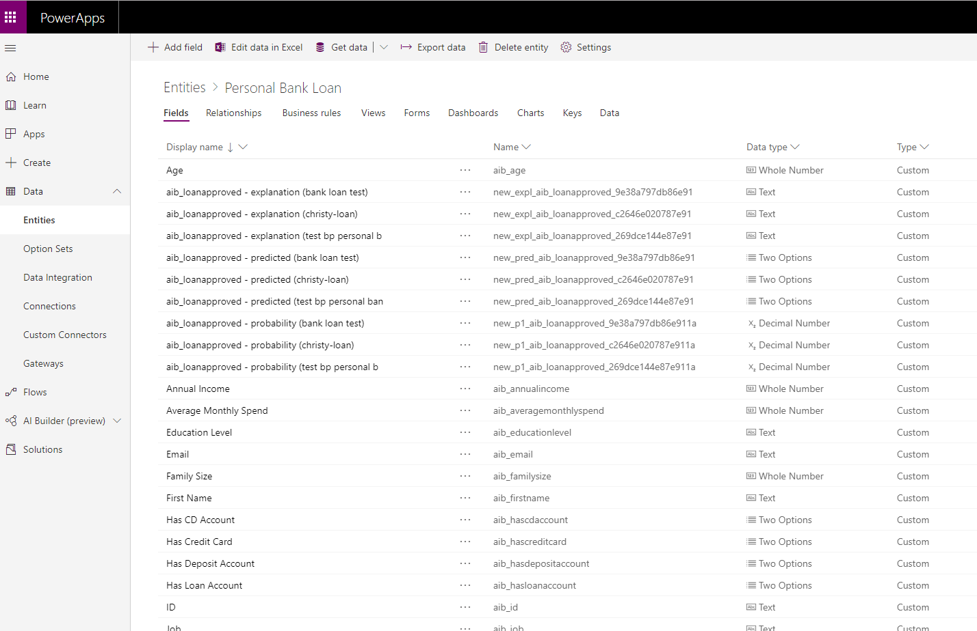
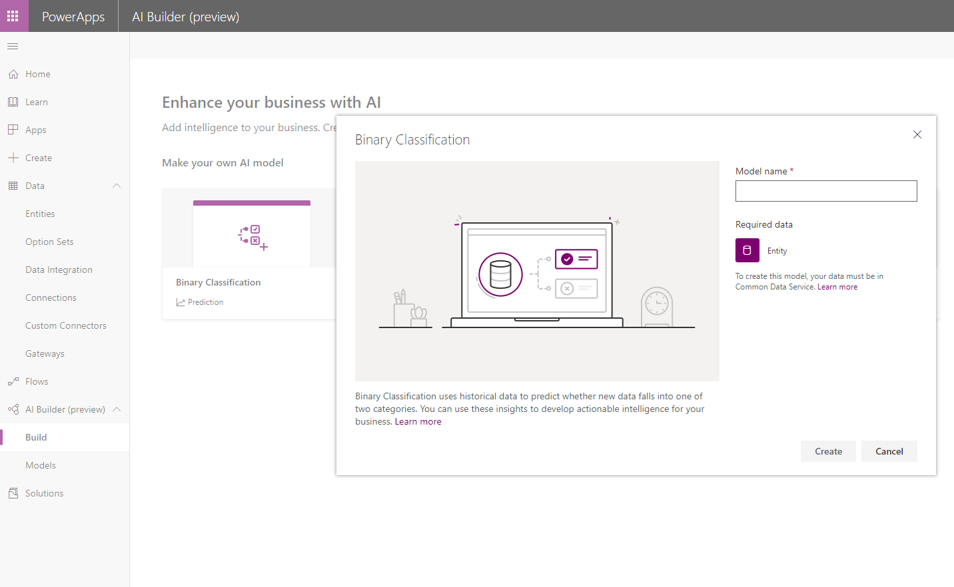


Bring in your unique business data: Historical outcomes and data
Point and click experience to build your unique AI classification model
Enhance your apps or flows with your predictions

Slide 16
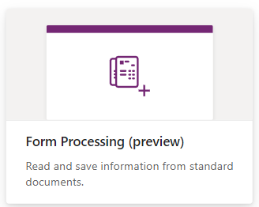
Form processing
Digitize your Forms to extract information,
store or process them​
Examples
Extract tax form information from PDF files
Extract invoice information from camera

Slide 17
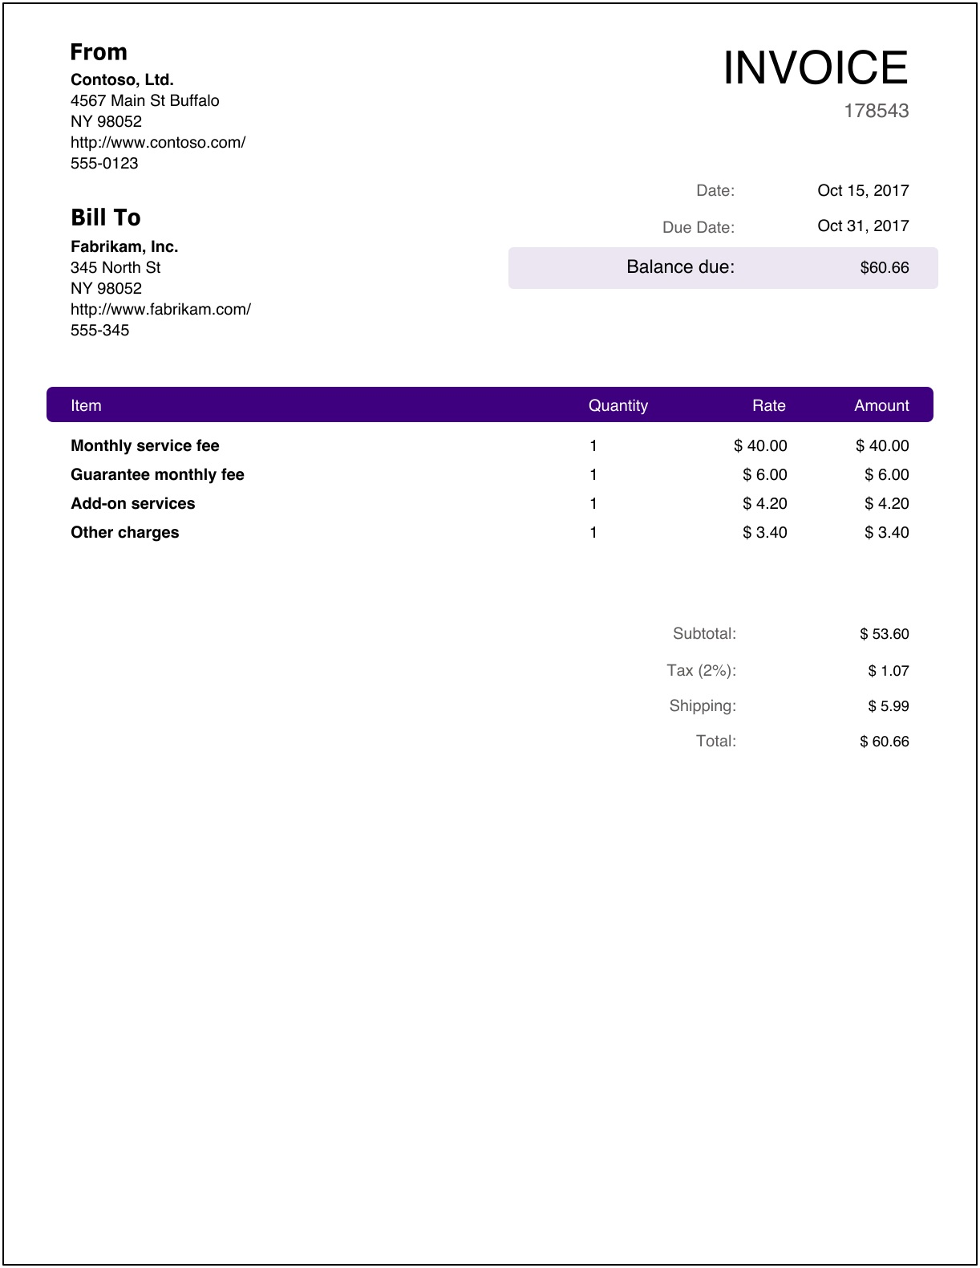
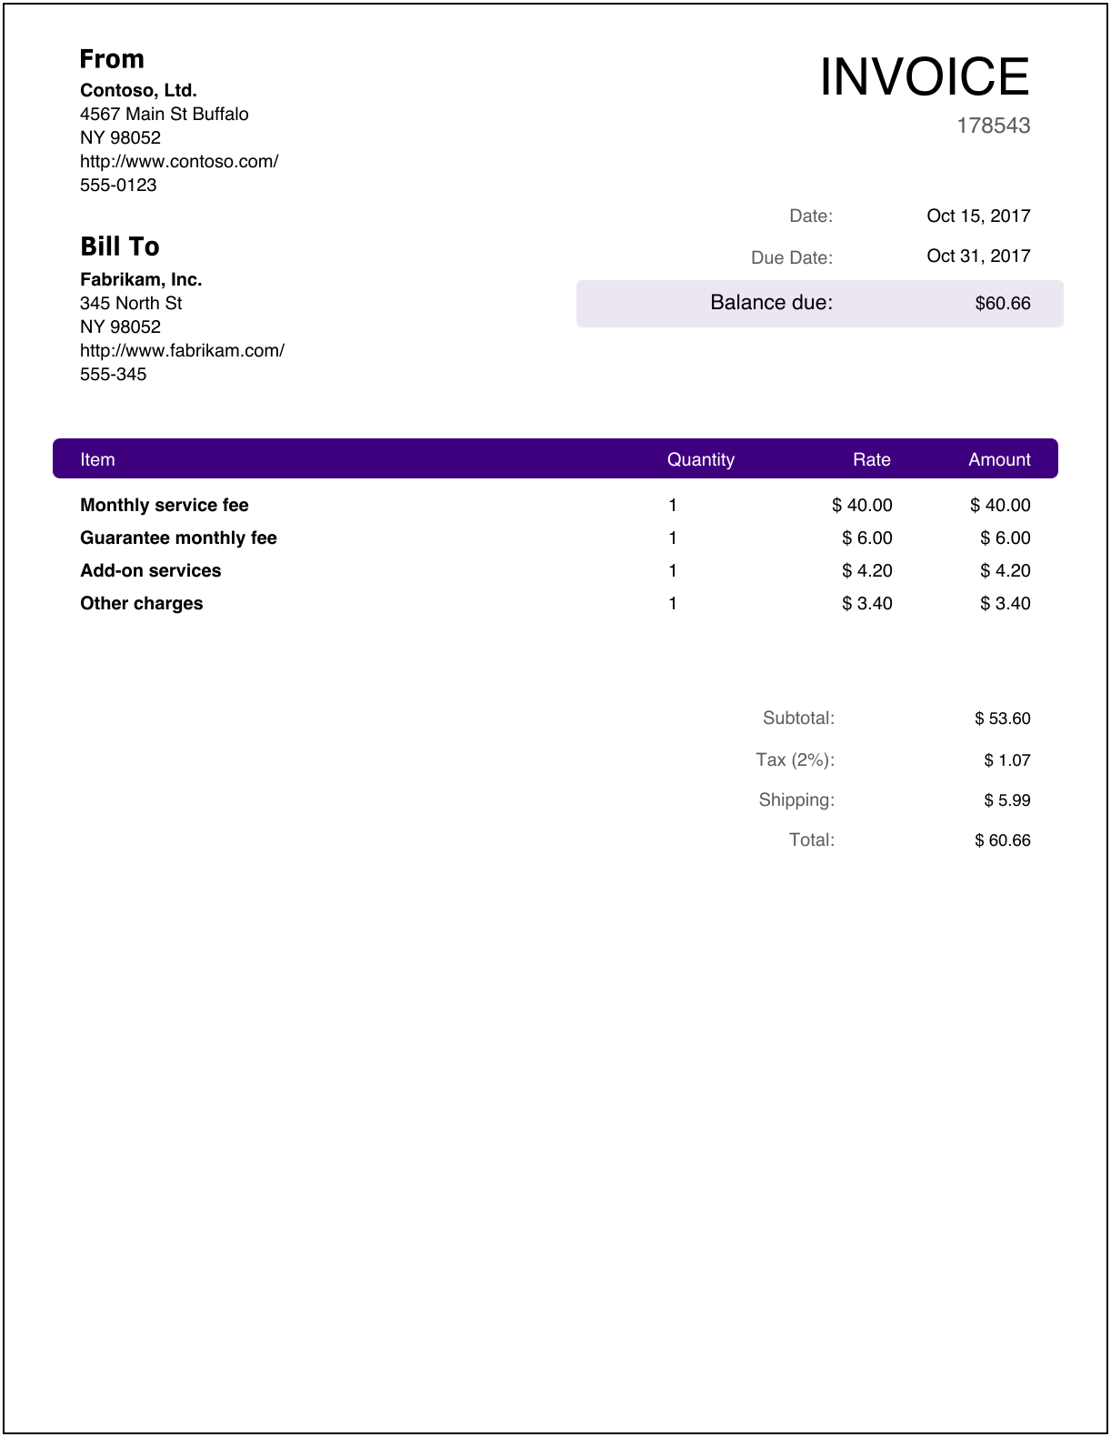

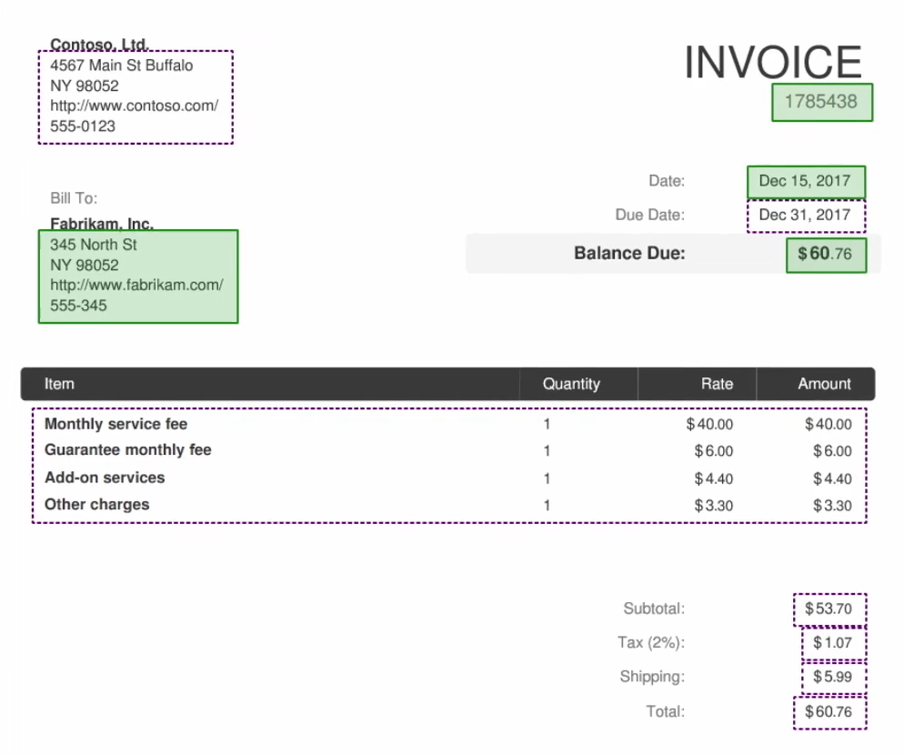
Point and click experience to build a model for a specific Form
Select the information you want to extract from that Form
Automate this Form processing using Microsoft Flow or PowerApps

Slide 18
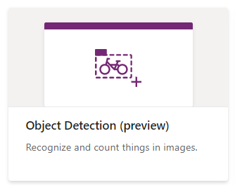
Object detection
Identify, count and locate objects in images​
Examples
Retail: product inventory detection from smartphone camera
Manufacturing: recognize parts of a machine

Slide 19

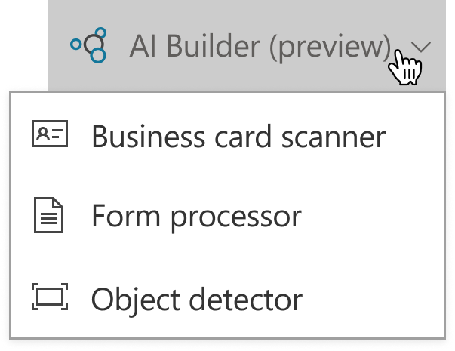

Point and click experience to build your unique AI model
Use pre-built PowerApps components to easily leverage your AI
Publish your application and all users will be able to consume your unique AI solution

Slide 20
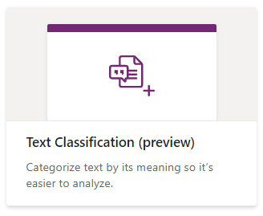
Text classification
Social media
Email
Documents
Feature request
Bug
Search
Automate text tagging to improve processes and extract untapped value from your data
Examples
Classify product feedback from customers
Route customer requests
…
…
…
…
…
…
…
…

Slide 21
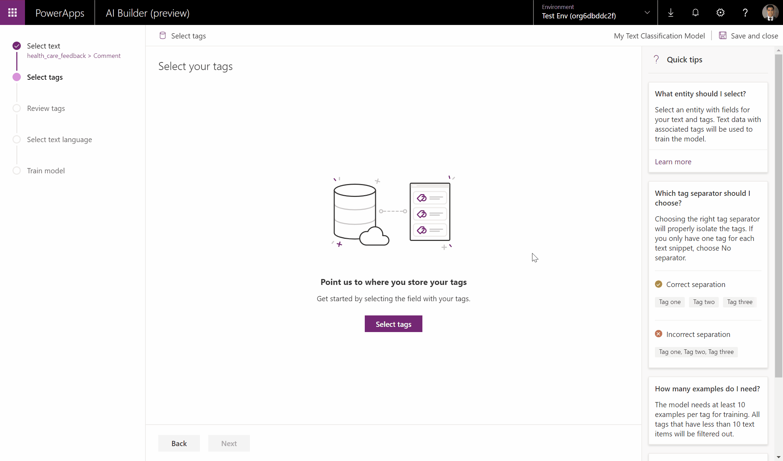
Bring in your unique business data: Text & Tags
…
…
…
…
…
…
Point and click experience to build your unique AI classification model
Automate your text processing using Microsoft Flow and your AI model
…
AI
…
…

Slide 22

Demo
Lab9-Object detection
Lab10-Form processing
Notes:
https://docs.microsoft.com/en-us/powerapps/maker/model-driven-apps/model-driven-app-overview
https://docs.microsoft.com/en-us/powerapps/maker/model-driven-apps/build-first-model-driven-app
https://docs.microsoft.com/en-us/powerapps/maker/model-driven-apps/model-driven-app-components

